Slide 1

{nottshcData}
Development of tools for querying, tidying, and analysing data in R

Slide 2







Lori Edwards Suárez
Clinical Analyst 💃
Background: NHS Expert
Fastest Mario Kart Driver in the Team
RiO Expert, Data Analysis
Chris Beeley
Senior Data Scientist 🧙‍♂️
Background: Clinical Psychology
Owns two cats named Pavlov and Freud
Shiny, Server Hosting
Oluwasegun Michael Apejoye
Data Science Intern 🥶
Background: Energy and environmental management
Enjoys working with health data
Forecasting, text mining, AI
Zoë Turner
Data Scientist 👩‍🌾
Background: Philosophy
Knows too much about data
SQL and data engineering
PAST MEMBERS
Andreas Soteriades
Data Scientist 🔮
Milan Wiedemann
Data Scientist 🐛

Slide 3
THE CHALLENGE

Slide 4

RiO (Mental Health Services)
SystmOne (Physical Health Services)
iaptus (Mental Health Services)
Ulysses (Incidents)
SUCE (Patient Experiences)

Slide 5
GET DATA
TIDY DATA
ANALYSE / VIZ DATA
DOCUMENT CODE
TEST CODE

Slide 6


{pkgs}

Slide 7



Get data
Tidy data
Analyse data
Visualise data
Communicate data
{honos}
{nottshcMethods}
Package for visualising and analysing the HoNOS (Health of the Nation Outcome Scales)
Helper funs for data manipulations, calculations, and visualisations
{nottshcData}
RiO (Mental Health Services)
{LSOApop}
{pxtextmining}
iaptus (Mental Health Services)
SystmOne (Physical Health Services)
Package with Lower layer Super Output Area (LSOA) population estimates and Indices of Multiple Deprivation (IMD) for England
Package for text classification of NHS patient experiences
Ulysses (Incidents)
SUCE (Patient Experiences)
{nottshcTeams}
{outcomesdashboard}
Helper funs to link clinical teams across different databases
Interactive dashboard presenting results to a selected group of clinicians, managers, or the public.

Slide 8
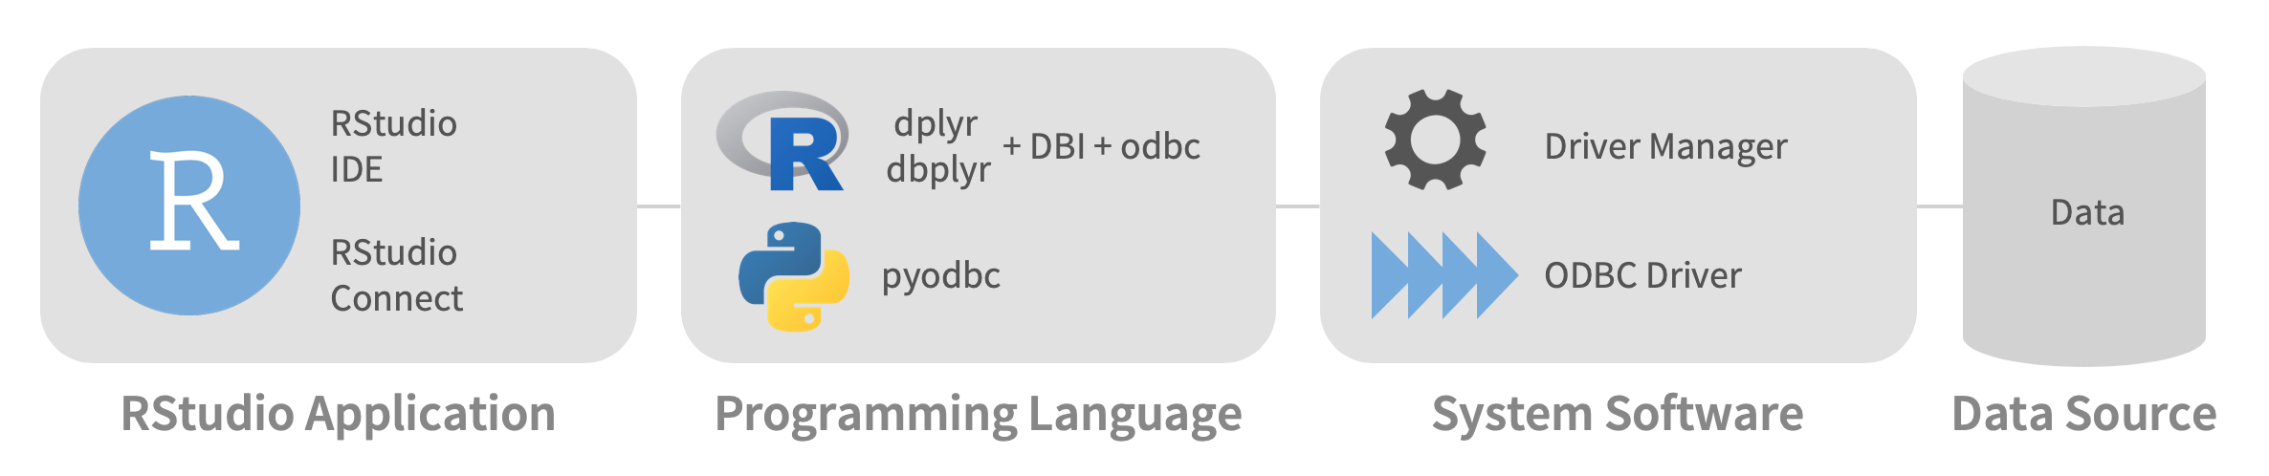


get_data() functions
tidy_data() functions
calc_xx_analysis() functions
Reference: https://db.rstudio.com/odbc/

Slide 9
calc_admission_length(client_id = ”123”,
max_gap_days = 2)
What is the
‘total admission length’ (internal and external) of a patient?
get_external_spell(from = “2020-01-01”)
get_internal_spell(from = “2020-01-01”)
tidy_external_spell(pivot_longer = F)
tidy_internal_spell(pivot_longer = F)
...
calc_teams_open_to(from = ”2020-01-01”, to = ”2021-12-31”,
primary_teams = c(”tm1”, ”tm2”),
secondary_team_status = ”seen”)
Which other teams are patients ‘open to’ while they are seen by one or more teams of interest?
get_referrals(from = “2020-01-01”)
get_referrals(from = “2020-01-01”)
tidy_referrals(pivot_longer = F)
tidy_referrals(pivot_longer = F)
filter(tm_code == primary_teams)
filter(tm_code != primary_teams)
...

Slide 10
calc_admission_length(client_id = ”123”,
max_gap_days = 2)
What is the
‘total admission length’ (internal and external) of a patient?
get_external_spell(from = “2020-01-01”)
get_internal_spell(from = “2020-01-01”)
tidy_external_spell(pivot_longer = F)
tidy_internal_spell(pivot_longer = F)
...
calc_teams_open_to(from = ”2020-01-01”, to = ”2021-12-31”,
primary_teams = c(”tm1”, ”tm2”),
secondary_team_status = ”seen”)
Which other teams are patients ‘open to’ while they are seen by one or more teams of interest?
get_referrals(from = “2020-01-01”)
get_referrals(from = “2020-01-01”)
tidy_referrals(pivot_longer = F)
tidy_referrals(pivot_longer = F)
filter(tm_code == primary_teams)
filter(tm_code != primary_teams)
...

Slide 11
AUTOMATION OF RECURRING TASKS
EASY TO DISTRIBUTE ACROSS TEAM
CONSISTENT WORKFLOW ACROSS ANALYSTS
MODULAR APPROACH
DISAGGREGATION of DATA vs ANALYSIS

Slide 12
BLOG POST
https://cdu-data-science-team.github.io/team-blog/posts/2021-08-06-nottshcverse/

Slide 13
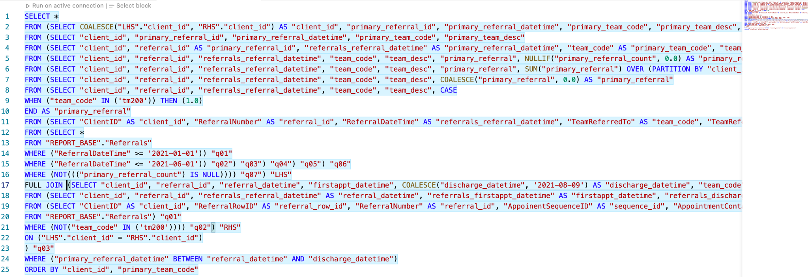
calc_teams_open_to(from = ”2020-01-01”, to = ”2021-12-31”,
primary_teams = c(”tm1”, ”tm2”),
secondary_team_status = ”seen”)
Which other teams are patients ‘under the care of’ while they are seen by one or more teams of interest?
get_referrals(from = “2020-01-01”)
get_referrals(from = “2020-01-01”)
tidy_referrals(pivot_longer = F)
tidy_referrals(pivot_longer = F)
filter(tm_code == primary_teams)
filter(tm_code != primary_teams)

Slide 14
calc_teams_open_to(from = ”2020-01-01”, to = ”2021-12-31”,
primary_teams = c(”tm1”, ”tm2”),
secondary_team_status = ”seen”)
Which other teams are patients ‘open to’ while they are seen by one or more teams of interest?
get_referrals(from = “2020-01-01”)
get_referrals(from = “2020-01-01”)
tidy_referrals(pivot_longer = F)
tidy_referrals(pivot_longer = F)
filter(tm_code == primary_teams)
filter(tm_code != primary_teams)

Slide 15
